Slide 1
Introduction to Linked Lists, Stacks and Queues
Mahdi Ebrahimi
Notes:
https://www.studytonight.com/data-structures/

Slide 2
Data structures
Ways to organize information to enable
efficient computation over that information
A data structure supports certain operations, each with a:
Meaning: what does the operation do/return
Performance: how efficient is the operation
Examples:
List with operations insert and delete
Stack with operations push and pop

Slide 3
Trade-offs
A data structure strives to provide many useful, efficient operations
But there are unavoidable trade-offs:
Time vs. space
One operation more efficient if another less efficient
Generality vs. simplicity vs. performance
We ask ourselves questions like:
Does this support the operations I need efficiently?
Will it be easy to use (and reuse), implement, and debug?
What assumptions am I making about how my software will be used? (E.g., more lookups or more inserts?)

Slide 4
Terminology
Abstract Data Type (ADT)
Mathematical description of a “thing” with set of operations
Algorithm
A high level, language-independent description of a step-by- step process
Data structure
A specific organization of data and family of algorithms for implementing an ADT
Implementation of a data structure
A specific implementation in a specific language

Slide 5
Example: Stacks
The Stack ADT supports operations:
isEmpty: have there been same number of pops as pushes
push: takes an item
pop: raises an error if empty, else returns most-recently pushed item not yet returned by a pop
… (possibly more operations)
A Stack data structure could use a linked-list or an array or something else, and associated algorithms for the operations
One implementation is in the library java.util.Stack

Slide 6
Linked Lists
Dynamic data structures Singly linked lists Generic linked lists Doubly linked lists

Slide 7
Array and Linked List
An array is a random access data structure, where each element can be accessed directly and in constant time. A typical illustration of random access is a book - each page of the book can be open independently of others. Random access is critical to many algorithms, for example binary search.
A linked list is a sequential access data structure, where each element can be accessed only in particular order. A typical illustration of sequential access is a roll of paper or tape - all prior material must be unrolled in order to get to data you want.
Notes:
ArrayList supports dynamic arrays that can grow as needed. Standard Java arrays are of a fixed length.

Slide 8
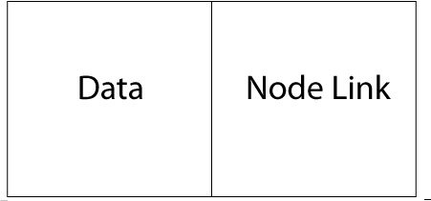
Linked List Data Structures
The core concept in a linked data structures is the node.
A data structure is a collection of nodes linked in a particular way. A node holds a data item and links to other nodes.
The nature of the links determines the kind of data structure, e.g., singly linked list, doubly linked list, binary tree, etc.
Here is a depiction of a node for a singly linked list and code that implements such a node (public members for brevity)
private class Node { public Object data; public Node next;
public Node(Object data, Node next) { this.data = data;
this.next = next;
}
}

Slide 9

Singly Linked Lists
A singly linked list
Contains a pointer to a “head” node (null if empty).
The head node’s next points to the second node, the second node’s next points to the third node, and so on.
The next reference of the last node is null
Here’s a depiction of the nodes in a singly linked list with three elements:

Slide 10
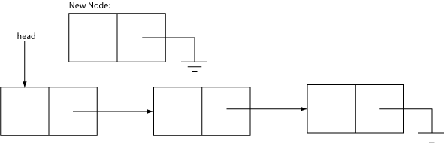
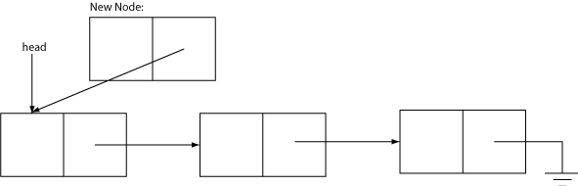
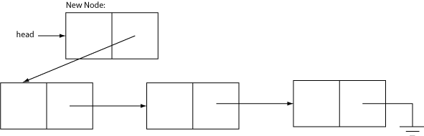
Adding Elements to a Singly Linked List
1. Create a new Node.
2. Set the next reference of the new Node to the current head.
3. Set the head reference to the new Node
Notes:
See LinkedList.java for the code.

Slide 11
Finding an Item in a Linked List
An algorithm for finding an item in a linked list:
foundNode: Node := null
currentNode: Node := LinkedList.head
while currentNode != null && foundNode = null if currentNode.data = queryItem
foundNode := currentNode
currentNode := currentNode.next
The postcondition of this algorithm is that foundNode will be:
The node containing the query item, or
null if the query item is not in the list.

Slide 12
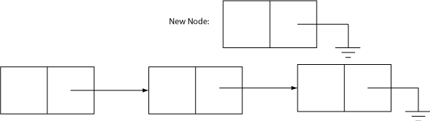

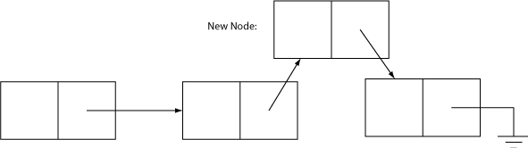
Inserting Elements into a Linked List
Find the existing Node to insert new element after.
Create a new Node.
3. Set the next reference of the new Node to the next reference of the existing node.
4. Set the next reference of the existing node to the new Node.

Slide 13
Computing the Length of a Linked List
An algorithm for computing the length a linked list:
length: int := 0
currentNode: Node := LinkedList.head while currentNode != null
length := length + 1
currentNode := currentNode.next
The postcondition of this algorithm is that length will be equal to the number of nodes in the list.

Slide 14
Generic Linked Lists
To make our LinkedList generic we only need to add a type parameter to the declaration:
public class GenericLinkedList<E> { ...
and replace Object with E in the body of the class.
Notes:
See GenericLinkedList.java
Linke: https://www.cs.usfca.edu/~wolber/SoftwareDev/Java/Collections/Lists/genericList.htm

Slide 15
Doubly Linked Lists
A doubly linked list simply adds a previous reference to the Node
class so that the list can be traversed forwards or backwards.
private class Node<E> { E data;
Node<E> next;
Node<E> previous;
public Node(E data, Node<E> next, Node<E> previous) { this.data = data;
this.next = next;
this.previous = previous;
}
}
Doubly linked lists work the same, except that the algorithms for inserting and removing items requires a bit more link fiddling (have to set previous links as well).
Notes:
See DoublyLinkedList.java.

Slide 16
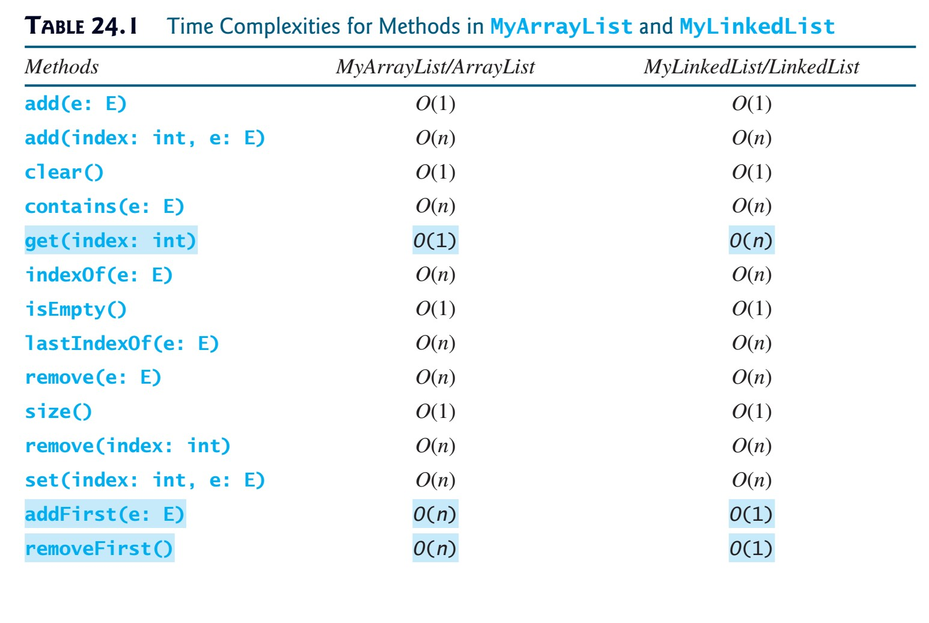
Running times of List operations

Slide 17
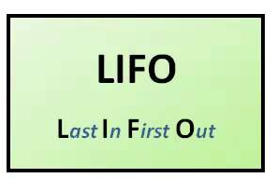
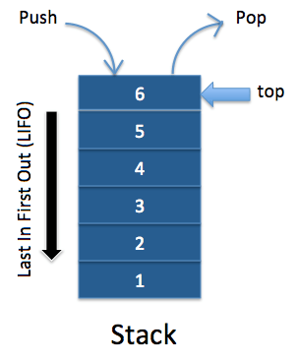
Stacks
A stack is a container of objects that are inserted and removed according to the last-in first-out (LIFO) principle.
In the pushdown stacks only two operations are allowed: push the item into the stack, and pop the item out of the stack.
A stack is a limited access data structure - elements can be added and removed from the stack only at the top. push adds an item to the top of the stack, pop removes the item from the top.
A helpful analogy is to think of a stack of books; you can remove only the top book, also you can add a new book on the top.
A stack is a recursive data structure. Here is a structural definition of a Stack:
a stack is either empty or
it consists of a top and the rest which is a stack;
Notes:
push(), pop(), peek(), search()

Slide 18
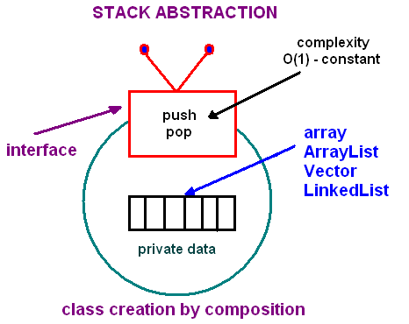
Stacks Implementation
The structure for a stack could be an array, a vector, an ArrayList, a linked list, or any other collection.
Regardless of the type of the underlying data structure, a Stack must implement the same functionality. This is achieved by providing a unique interface:
public interface StackInterface <AnyType>
{
public void push(AnyType e);
public AnyType pop();
public AnyType peek();
public boolean isEmpty();
}
Notes:
Another implementation requirement (in addition to the above interface) is that all stack operations must run in constant time O(1). Constant time means that there is some constant k such that an operation takes k nanoseconds of computational time regardless of the stack size.

Slide 19
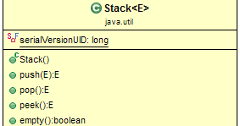
Stacks Implementation
push(): Adds an item into (top of) the stack
pop(): Removes the item from the top of the stack.
peek(): Retrieves the first element of the Stack or the element present at the top of the Stack.
empty(): Check if a stack is empty or not.
search(), min(), …
Notes:
push(), pop(), peek(), search()

Slide 20
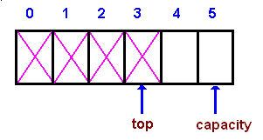
Stacks Implementation - Array-based
In an array-based implementation we maintain the following fields:
an array A of a default size (≥ 1), the variable top that refers to the top element in the stack
and the capacity that refers to the array size.
The variable top changes from -1 to capacity - 1.
We say that a stack is empty when top = -1, and the stack is full when top = capacity-1.
Notes:
Another implementation requirement (in addition to the above interface) is that all stack operations must run in constant time O(1). Constant time means that there is some constant k such that an operation takes k nanoseconds of computational time regardless of the stack size.

Slide 21
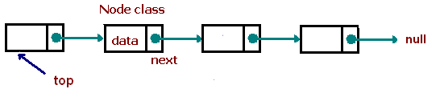
Stacks Implementation - Linked List-based
Linked List-based implementation provides the best (from the efficiency point of view) dynamic stack implementation.
Notes:
Another implementation requirement (in addition to the above interface) is that all stack operations must run in constant time O(1). Constant time means that there is some constant k such that an operation takes k nanoseconds of computational time regardless of the stack size.

Slide 22
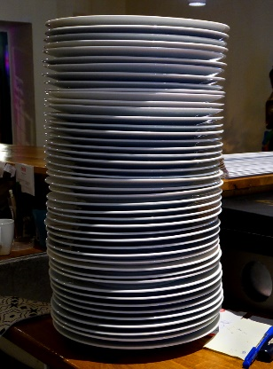
Stacks Applications
The simplest application of a stack is to reverse a word. You push a given word to stack - letter by letter - and then pop letters from the stack.
Another application is an "undo" mechanism in text editors; this operation is accomplished by keeping all text changes in a stack.
Notes:
push(), pop(), peek(), search()

Slide 23
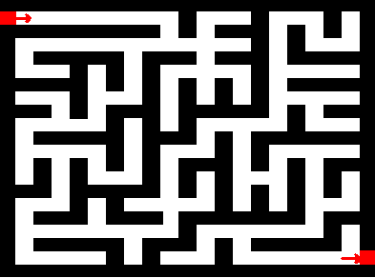
Stacks Applications
Backtracking. This is a process when you need to access the most recent data element in a series of elements. Think of a labyrinth or maze - how do you find a way from an entrance to an exit?
Once you reach a dead end, you must backtrack. But backtrack to where? to the previous choice point. Therefore, at each choice point you store on a stack all possible choices. Then backtracking simply means popping a next choice from the stack.
Notes:
push(), pop(), peek(), search()

Slide 24
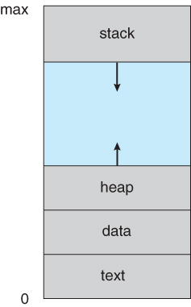
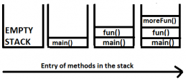
Stacks Applications
Language processing:
Space for parameters and local variables is created internally using a stack.
Compiler's syntax check for matching braces is implemented by using stack.
Notes:
push(), pop(), peek(), search()

Slide 25
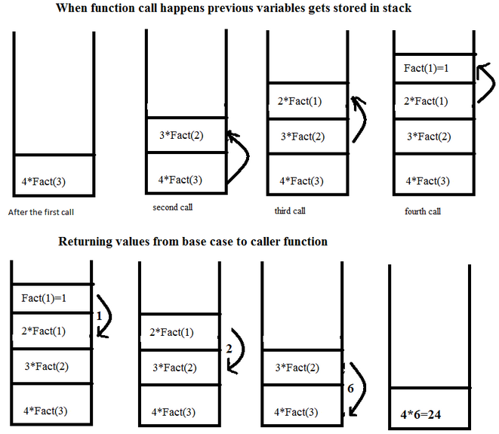
Stacks Applications
Language processing:
Support for recursion
Notes:
push(), pop(), peek(), search()

Slide 26
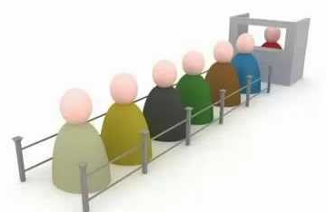
Queues
A queue is a container of objects (a linear collection) that are inserted and removed according to the first-in first-out (FIFO) principle. An excellent example of a queue is a line of students in the food court of the CSUN. New additions to a line made to the back of the queue, while removal (or serving) happens in the front. In the queue only two operations are allowed enqueue and dequeue.
Enqueue means to insert an item into the back of the queue, dequeue means removing the front item. The picture demonstrates the FIFO access.
The difference between stacks and queues is in removing. In a stack we remove the item the most recently added; in a queue, we remove the item the least recently added.
Notes:
push(), pop(), peek(), search()

Slide 27
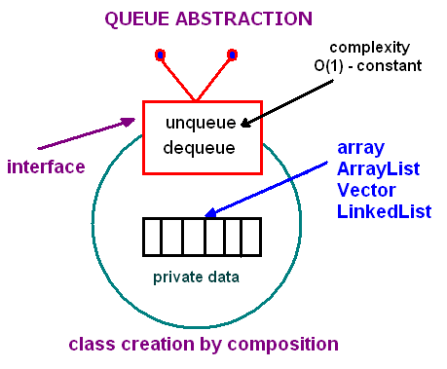
Queues Implementation
The structure for a queue could be an array, a Vector, an ArrayList, a LinkedList, or any other collection.
Regardless of the type of the underlying data structure, a queue must implement the same functionality. This is achieved by providing a unique interface.
interface QueueInterface ‹AnyType>
{
public boolean isEmpty();
public AnyType getFront();
public AnyType dequeue();
public void enqueue(AnyType e);
public void clear();
}
Notes:
Each of the above basic operations must run at constant time O(1). The following picture demonstrates the idea of implementation by composition.

Slide 28
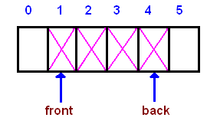

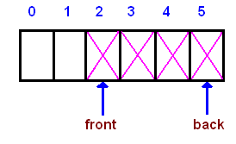
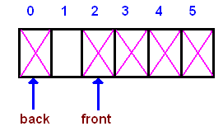
Circular Queues
Given an array A of a default size (≥ 1) with two references back and front, originally set to -1 and 0 respectively. Each time we insert (enqueue) a new item, we increase the back index; when we remove (dequeue) an item - we increase the front index.
As you see from the picture, the queue logically moves in the array from left to right. After several moves back reaches the end, leaving no space for adding new elements.
However, there is a free space before the front index. We shall use that space for enqueueing new items, i.e. the next entry will be stored at index 0, then 1, until front. Such a model is called a wrap around queue or a circular queue.
Notes:
The circular queue implementation is done by using the modulo operator (denoted %), which is computed by taking the remainder of division (for example, 8%5 is 3). By using the modulo operator, we can view the queue as a circular array, where the "wrapped around" can be simulated as "back % array_size". In addition to the back and front indexes, we maintain another index: cur - for counting the number of elements in a queue. Having this index simplifies a logic of implementation.

Slide 29
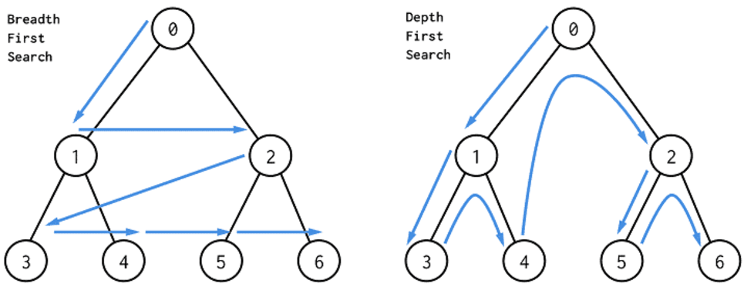
Stacks/Queues Applications – search tree
Breadth-First Search with a Queue
In breadth-first search we explore all the nearest possibilities by finding all possible successors and enqueue them to a queue.
Create a queue
Create a new choice point
Enqueue the choice point onto the queue
while (not found and queue is not empty)
Dequeue the queue
Find all possible choices after the last one tried
Enqueue these choices onto the queue
Return
Depth-First Search with a Stack
In depth-first search we go down a path until we get to a dead end; then we backtrack or back up (by popping a stack) to get an alternative path.
Create a stack
Create a new choice point
Push the choice point onto the stack
while (not found and stack is not empty)
Pop the stack
Find all possible choices after the last one tried
Push these choices onto the stack
Return
Notes:
push(), pop(), peek(), search()

